Slide 1

Wine
Quality
Predictor
Erin Buday, Derek Mast, Muhammad Malik, Rolly Costillas

Slide 2
AGENDA
Objective
Data Description
Data Analysis
Insights from Analysis

Slide 3
OBJECTIVE
Create a machine learning model that determines the quality of a wine. Allowing business owners to make smart inventory and pricing decisions.

Slide 4
DATASET
1599 data points of each wine with 11 characteristics.
Wine quality is measured on 0 (low) – 10 (high) scale.
Data set contains information about red varietals of the Portuguese wine “Vinho Verde”.

Slide 5
WINE CHARACTERISTICS
Fixed acidity
Volatile acidity
Citric acid
Residual sugar
Chlorides
Free sulfur dioxide
Density
pH
Sulphates
Alcohol

Slide 6
ANALYSIS
03.
01.
04.
02.
Clean Data
Check for null values and missing data.
PostgresSQL
Test Models
Test 3 different models to determine best outcome.
Create a database and table and uploaded the dataset CSV file into the table.
Python
Tableau
05.
Pull data from PostgresSQL into Python.
Create visualizations using the data.

Slide 7
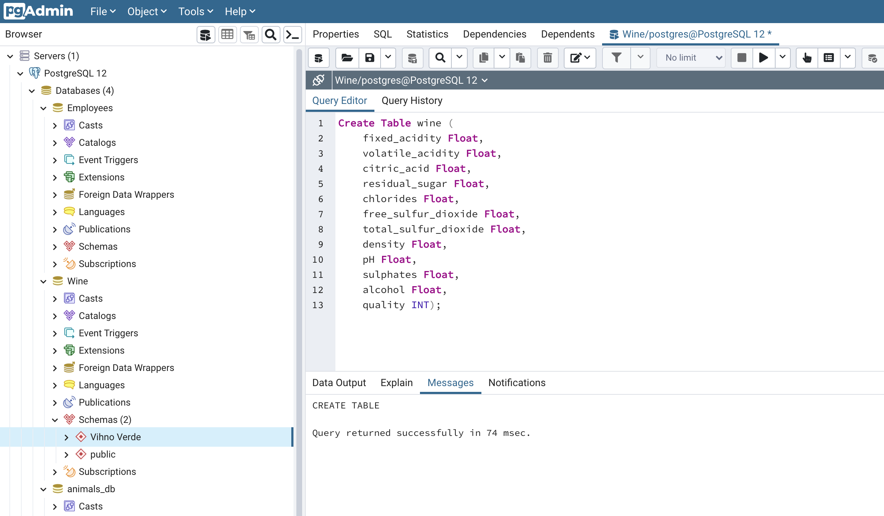
01.

Slide 8
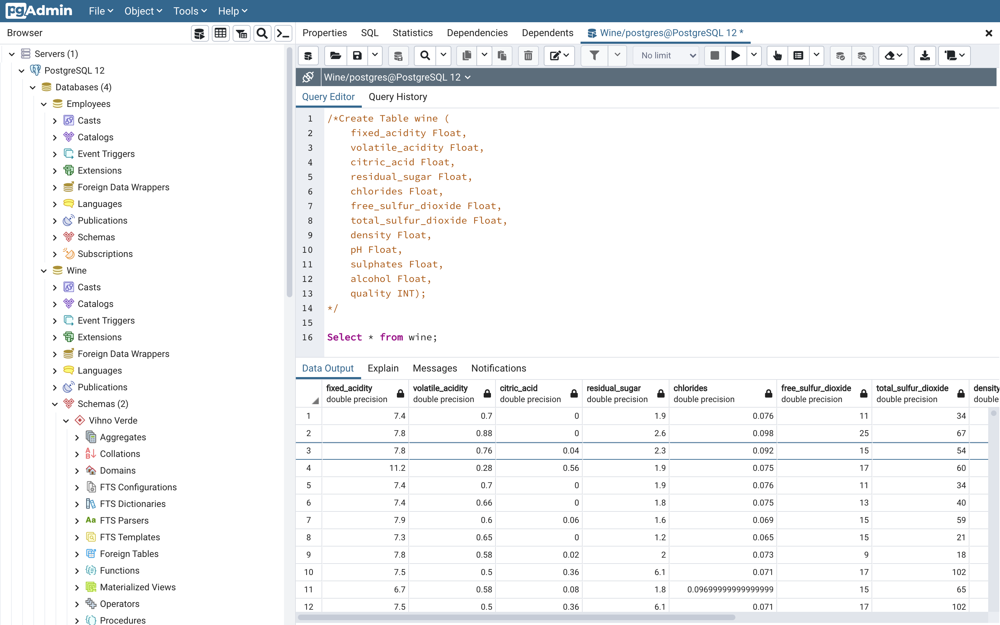

Slide 9
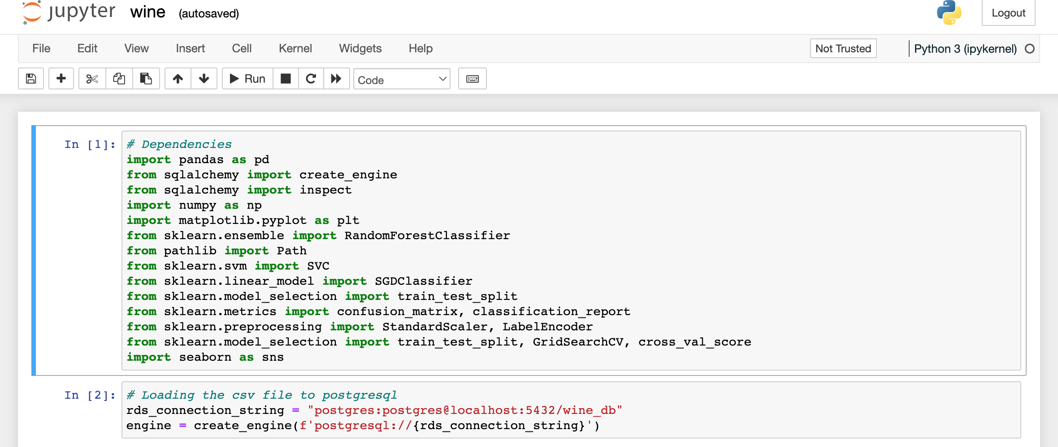
02.

Slide 10
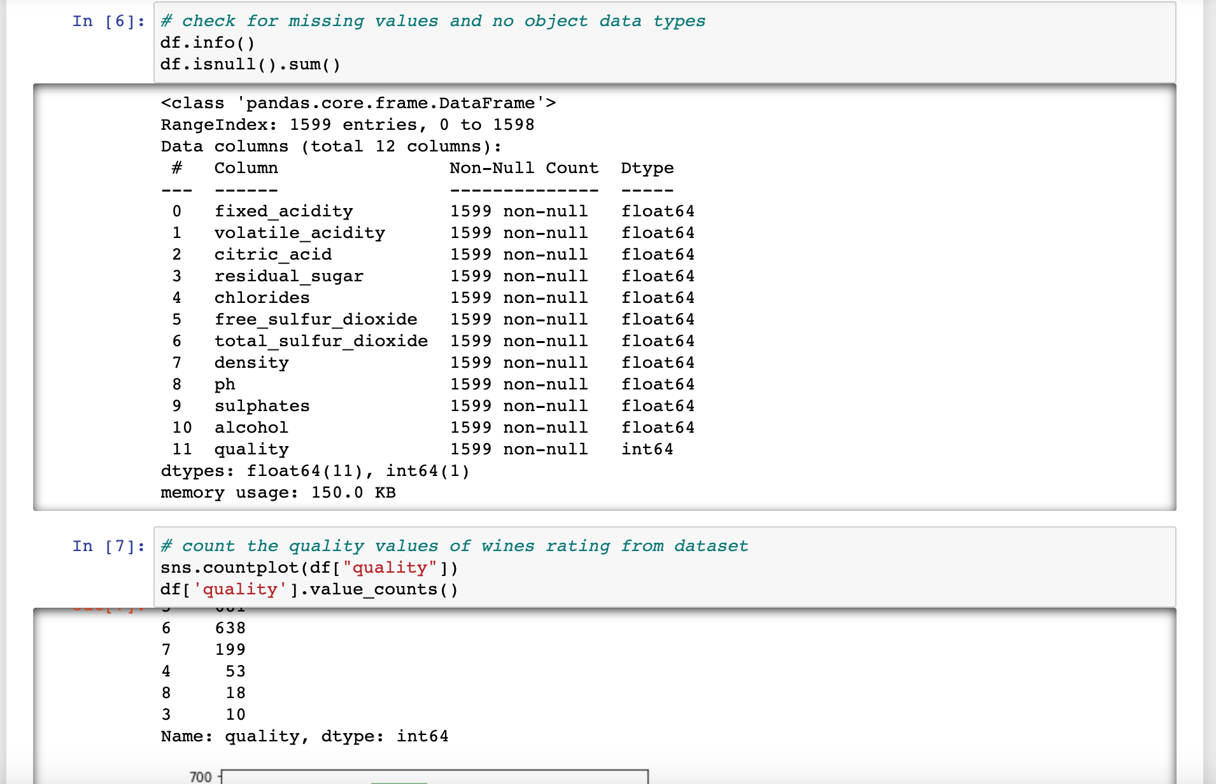
03.

Slide 11
TESTING MODELS
Random Forest Classifier
Random Forest Regression is a supervised learning algorithm that uses ensemble learning method for regression. Ensemble learning method is a technique that combines predictions from multiple machine learning algorithms to make a more accurate prediction than a single model
Support Vector Classifier
Support vector machines (SVMs) are a set of supervised learning methods used for classification, regression and outliers detection. The advantages of support vector machines are: Effective in high dimensional spaces. Still effective in cases where number of dimensions is greater than the number of samples.

Slide 12
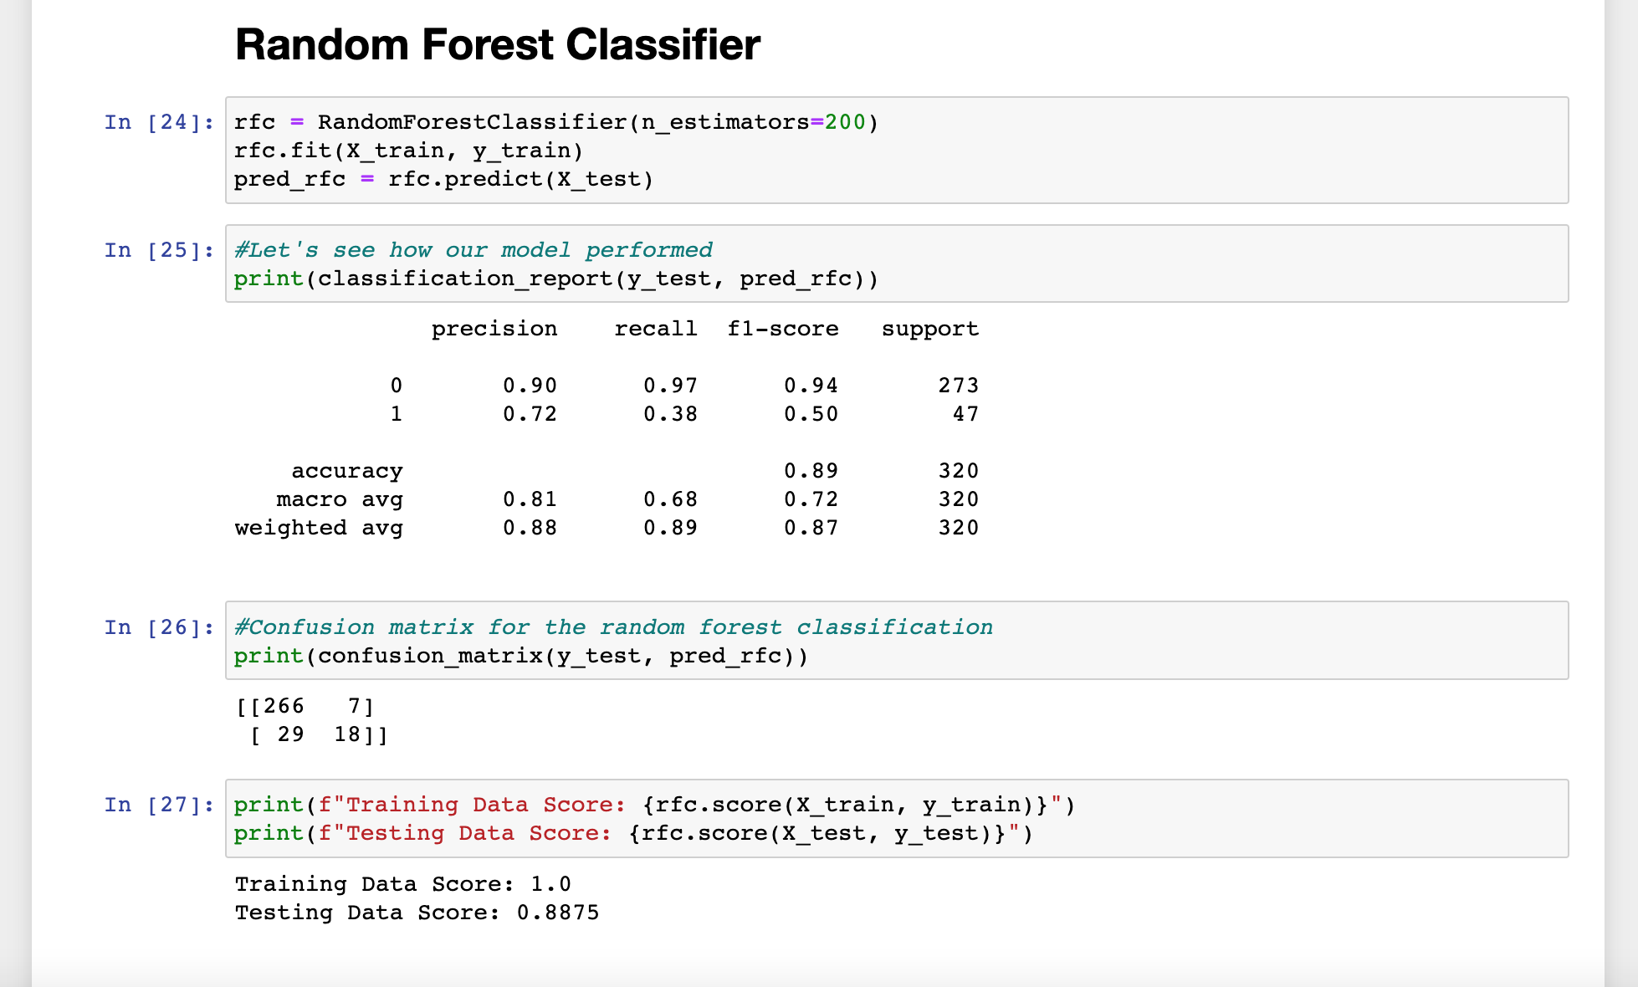
04.

Slide 13
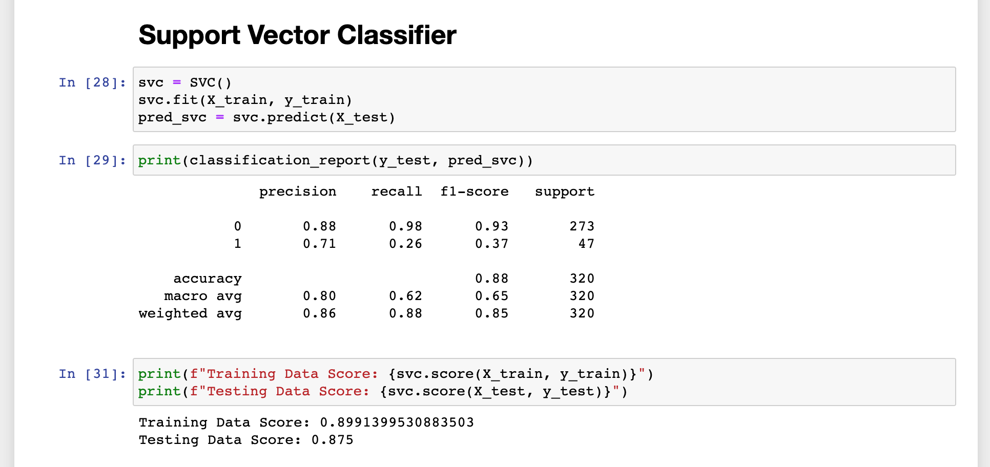

Slide 14
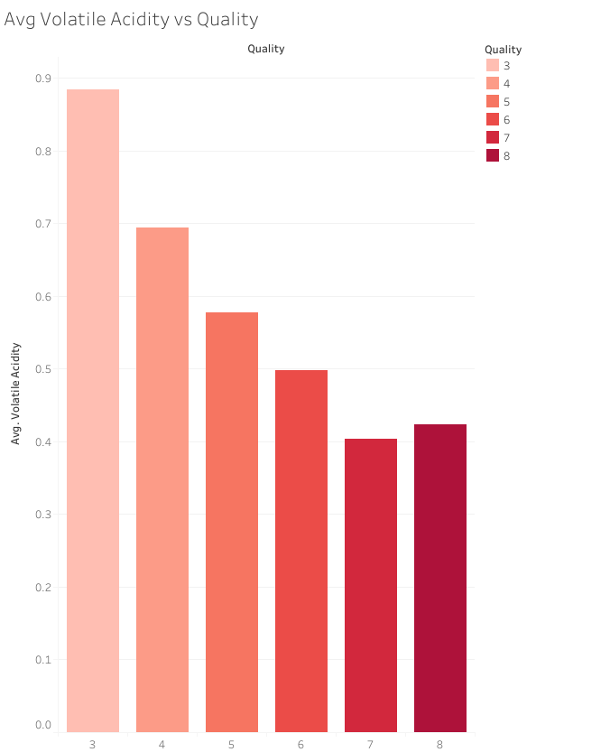
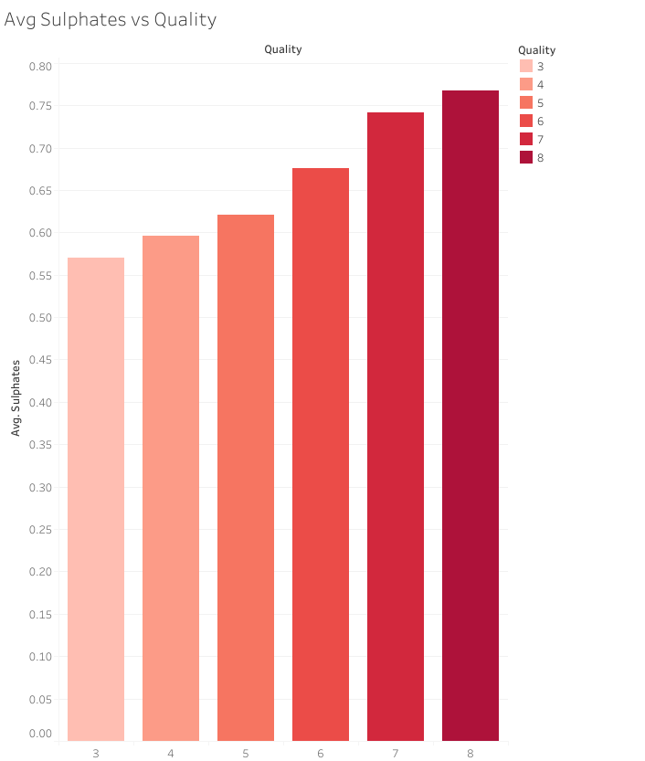
Tableau
05.

Slide 15
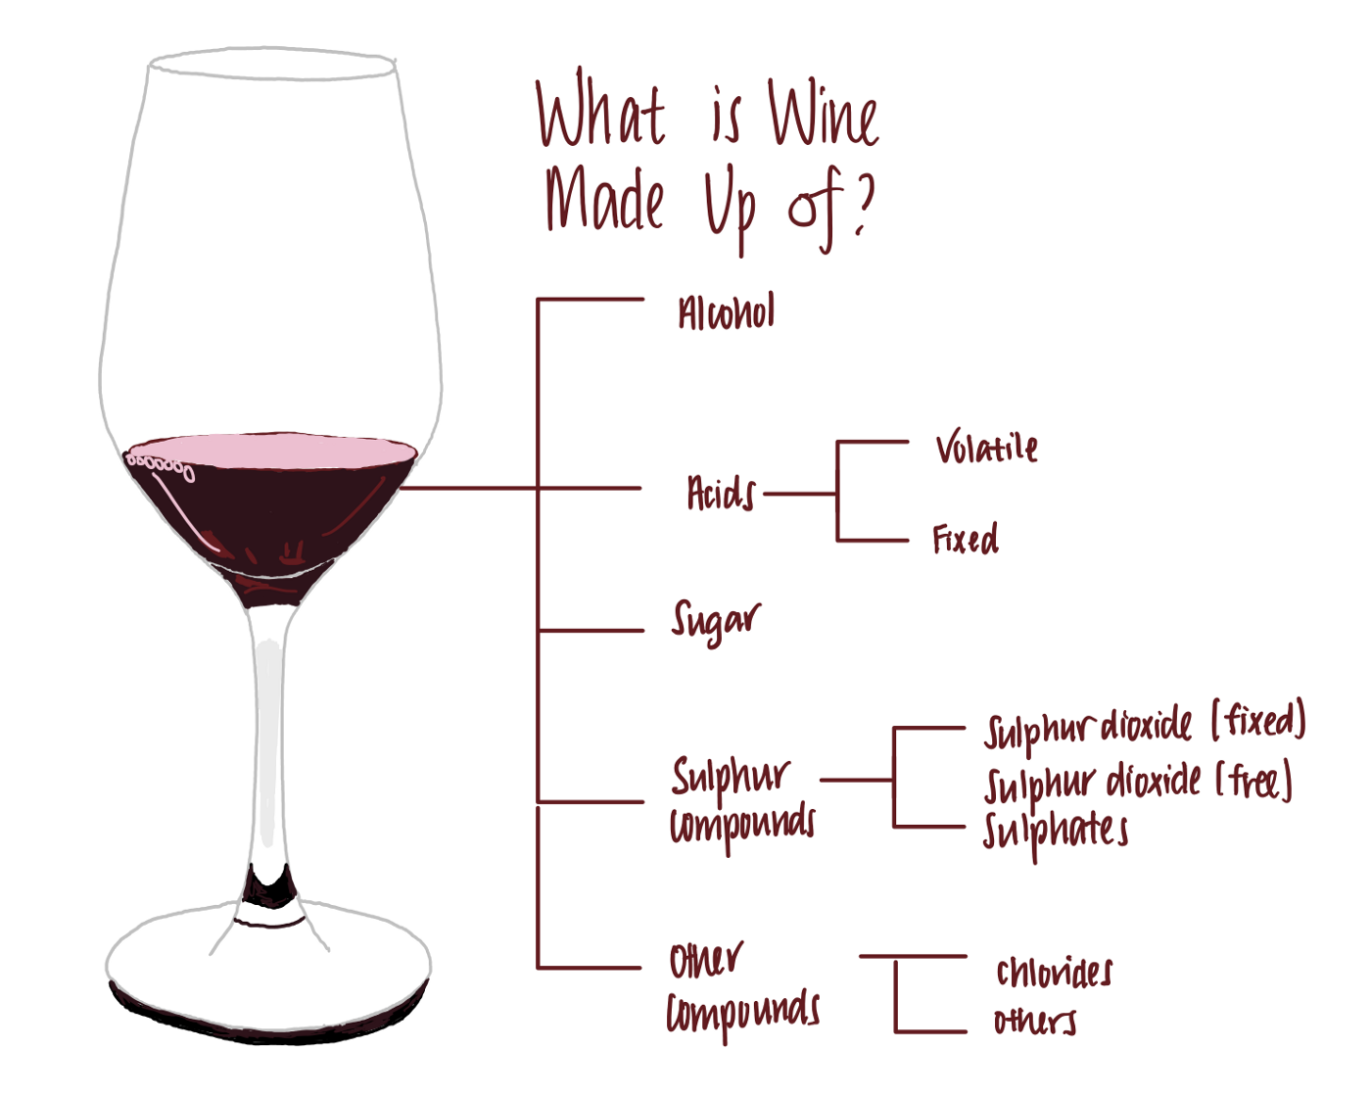
LEADING ATTRIBUTES
01. Alcohol
02. Sulphates
03. Volatile Acidity

Slide 16
CONCLUSION
The best model to use was a Support Vector Classifier.
Wine quality is determined by alcohol content, sulphates and volatile acidity. Higher alcohol content and sulphates combined with low volatile acidity make a high-quality wine.
Use of this model would allow a wine store to make smart business decisions by knowing the quality of the wine and pricing the product appropriately and competitively.

Slide 17


CHEERS!

